Slide 1




Predicting Customer Churn for Business Growth
Unveiling insights from a robust machine learning pipeline to proactively address customer churn and drive retention strategies.
Ing. Bárbara Ortiz – Data Scientist Jr – ONE Oracle Next Education

Slide 2
Agenda
Project Overview
01
02
03
Analytical Summary
Project Outline
Model Comparison
Overview of churn prediction pipeline
Steps taken in the analysis
Performance evaluation of ML models
04
05
06
Key Factors
Patterns Identified
Strategies to Reduce Churn
Drivers of customer churn
High-risk and protected segments
Actionable retention plans
07
Conclusion
Summary of findings and next steps
Ing. Bárbara Ortiz – Data Scientist Jr – ONE Oracle Next Education

Slide 3
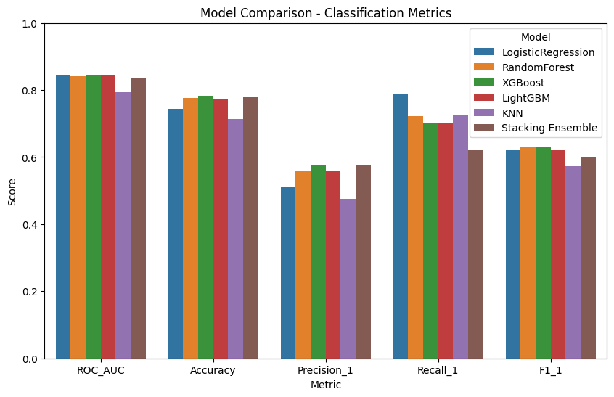
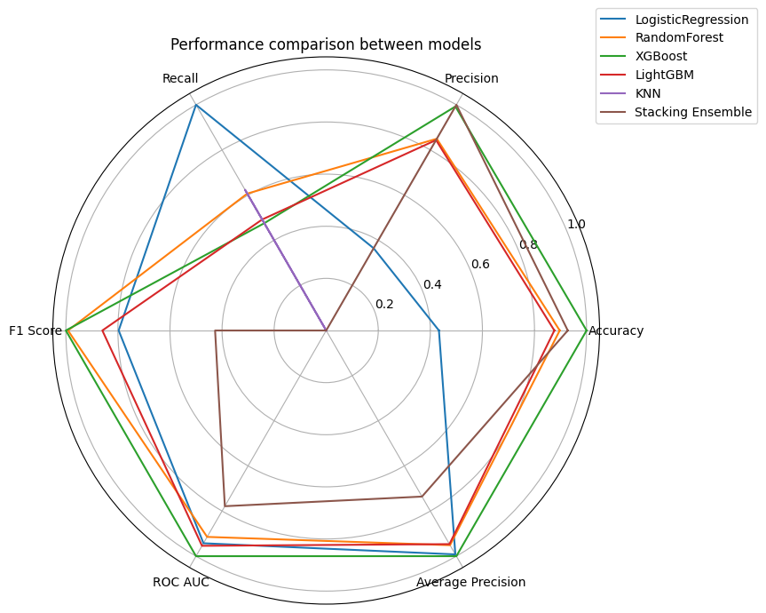
Section 1
Analytical Summary
A robust pipeline was built to anticipate customer churn using machine learning techniques and explanatory analytics.
The XGBoost model performed best, standing out for its robustness, balance, and ability to correctly identify the positive class (churn).
Ing. Bárbara Ortiz – Data Scientist Jr – ONE Oracle Next Education

Slide 4
Section 2
Project Outline: Our Methodical Approach
Our analysis followed a comprehensive, multi-stage process to ensure accuracy and interpretability:
Exploratory Analysis & Data Preparation
1
Initial data understanding and cleaning.
2
Correlation Analysis & Balancing
Identifying relationships and addressing data imbalance.
Multi-Model Training & Optimization
3
KNN, LG RF, RL, XGB, and Ensemble models with hyperparameter tuning (GridSearchCV).
4
Model Comparison & Interpretation
Evaluating performance and understanding feature contributions (SHAP & Feature Importance).
Final Report & Strategy
5
Consolidating insights into actionable recommendations.
Ing. Bárbara Ortiz – Data Scientist Jr – ONE Oracle Next Education

Slide 5
Section 3
Model Comparison: Performance Metrics
After rigorous evaluation, the XGBoost model demonstrated superior overall balance and predictive power.
Model
Accuracy
Precision
Recall
F1 Score
ROC AUC
Observations
XGBoost
0.783
0.575
0.701
0.631
0.845
Good overall balance, excellent ROC AUC, and high recall
LightGBM
0.774
0.560
0.703
0.623
0.843
Very similar to XGBoost, good recall and precision
RandomForest
0.776
0.560
0.722
0.631
0.841
High recall, good overall balance
LogisticRegression
0.744
0.511
0.786
0.620
0.843
Better recall (sensitivity), lower precision
Stacking Ensemble
0.779
0.578
0.623
0.600
0.834
Better precision, slightly lower recall and F1
KNN
0.714
0.475
0.725
0.574
0.794
Lower accuracy and precision, but acceptable recall
Ing. Bárbara Ortiz – Data Scientist Jr – ONE Oracle Next Education

Slide 6

Section 3
Confusion Matrix Insights
Analysis of the Confusion Matrix confirms XGBoost's effectiveness in balancing churn identification and false alarms.
Model
TN
FP
FN
TP
Observations
XGBoost
841
194
112
262
Better TN (low FP), FN similar to LightGBM
LightGBM
828
207
111
263
Good Balance, somewhat more FN than KNN, but less FP
RandomForest
823
212
104
270
Balanced, FN slightly better than XGBoost
LogisticRegression
754
281
80
294
Better FN (fewer false negatives), more FP (risk of higher costs)
Ensemble (Stacking)
865
170
141
233
Better TN (less FP), more FN (risk of losing churning customers)
KNN
735
300
103
271
Good Recall (high TP), many False Positives (high FP)
🎯 Selected Model: XGBoost. Robust, well-balanced, and ideal for minimizing customer loss (high recall) while avoiding false alarms (reasonable accuracy). Adapts well to various business cases.
Ing. Bárbara Ortiz – Data Scientist Jr – ONE Oracle Next Education

Slide 7

Section 4
Key Churn Factors
We utilized SHAP and correlation analysis to identify variables influencing churn probability.
Factors Increasing Churn:
Factors Decreasing Churn:
Contract Month to Month: Low commitment, easy to leave.
Customer Tenure: Longer tenure, greater loyalty.
Internet Fiber Optic: Customers with more alternatives.
Two-year Contract: Long contracts limit exits.
Payment Electronic Check: Volatile profile, lower contractual commitment.
Internet TechSupport: Technical support adds value, reduces churn.
Paperless Billing: Digital customer, often attentive to new offers.
Internet OnlineSecurity: Additional protections build trust.
No Internet: Less incentive to leave.
Mixed Effects:
Internet StreamingMovies & StreamingTV: Effect depends on other variables (e.g., contract type, additional services).
Ing. Bárbara Ortiz – Data Scientist Jr – ONE Oracle Next Education

Slide 8
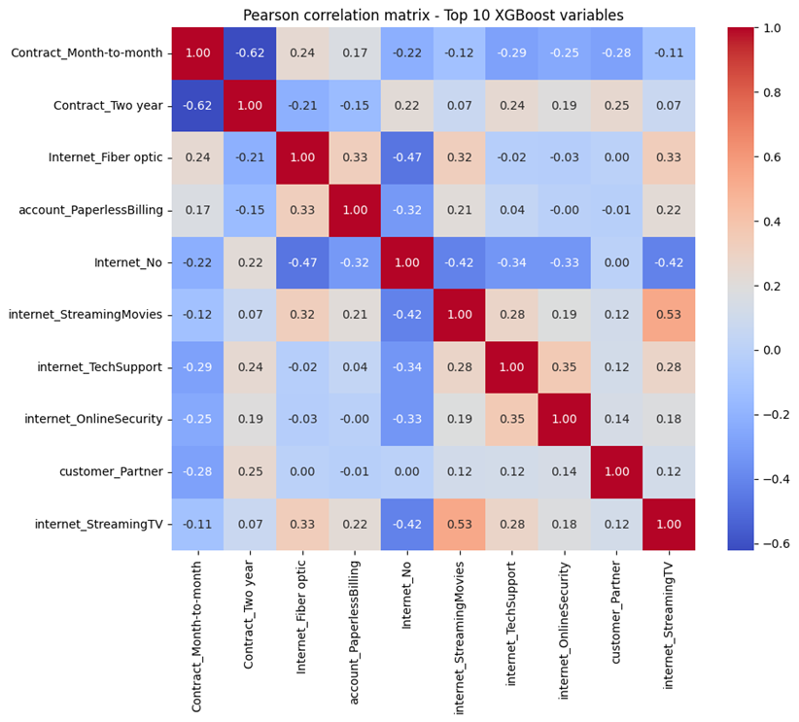
Section 5
Identified Churn Patterns
High-Risk Segment
Monthly contracts, low tenure.
Fiber optics, e-check payments, e-invoicing.
Profile: Digital-savvy, short-term commitment, potentially flighty.
Protected Segment
Two-year contracts, long tenure.
Utilize additional services (tech support, online security).
Profile: Loyal, value-added service-oriented, stable.
Key Interactions: Long contract + additional services maximize retention. New customer + monthly contract + digital services = highest risk.
Ing. Bárbara Ortiz – Data Scientist Jr – ONE Oracle Next Education

Slide 9
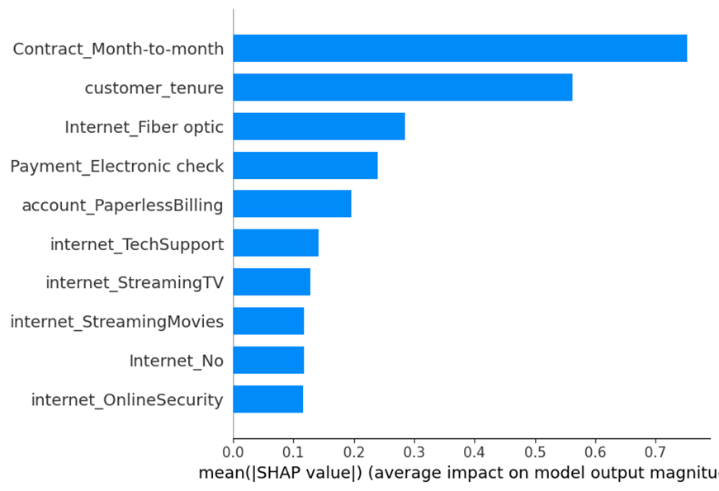
Section 6
Actionable Churn Reduction Strategies
High-Retention Customers
High-Risk Customers
Enhance technical support & security.
Incentivize longer contracts with benefits.
Offer upgrades and bundled packages.
Improve fiber service experience & promotions.
Proactive loyalty programs.
Promote automatic payment methods.
Personalize digital communications.
General Strategies
Improve onboarding for initial engagement.
Use predictive models for early detection.
Optimize digital self-service and support.
Personalize streaming offers based on profile and bundle
with other services.
Ing. Bárbara Ortiz – Data Scientist Jr – ONE Oracle Next Education

Slide 10
Conclusion
Driving Loyalty, Reducing Churn
Robust Pipeline
Interpretable Insights
Advanced preprocessing, variable selection, and class balancing significantly improved predictive capacity.
Combined SHAP with non-linear models for clear, explainable churn drivers.
Key Factors Validated
Actionable Strategies
Contract type, payment method, customer tenure, and additional services are primary churn influences.
Derived strategies are clear, actionable, and ready for immediate implementation by marketing and retention teams.
This combined approach provides a solid foundation for designing customized interventions to increase loyalty and reduce customer churn.
Ing. Bárbara Ortiz – Data Scientist Jr – ONE Oracle Next Education

Slide 11

Thank you!
Questions and Next Steps
Download the complete report here
Ing. Bárbara Ortiz – Data Scientist Jr – ONE Oracle Next Education

